Slide 1
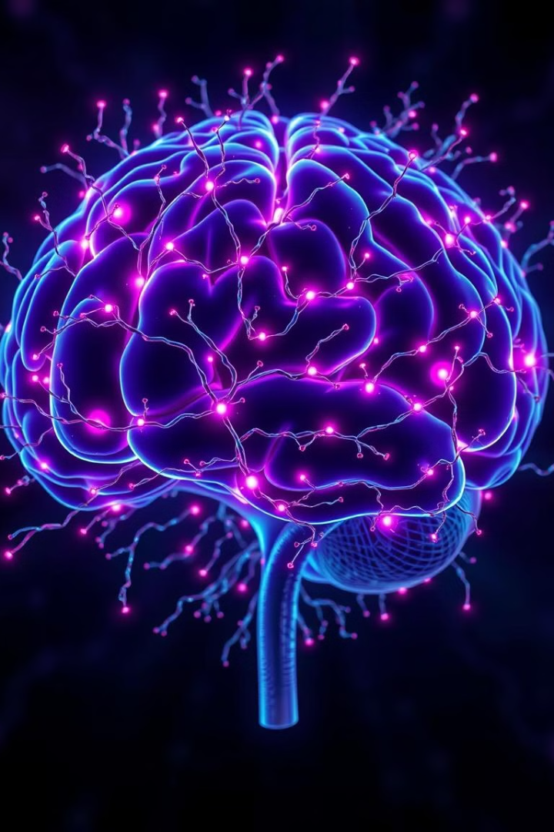

Brain Tumor Detection: Revolutionizing Medical Imaging
This presentation outlines a groundbreaking project to leverage the power of deep learning for accurate brain tumor detection. We aim to develop an AI-powered system that assists radiologists in identifying brain tumors from MRI scans, improving diagnostic accuracy and enabling timely treatment.
by Lopamudra Nayak

Slide 2
The Need for AI in Brain Tumor Detection
Challenges with Traditional Methods:
Objective:
Current methods of brain tumor detection rely on manual analysis of MRI images, which is labor-intensive, time-consuming, and prone to human error. This can lead to delays in diagnosis, hindering effective treatment.
Deep learning offers a robust solution by automating the process of tumor detection. By training models on vast datasets of MRI scans, we can develop algorithms that accurately classify brain tumors, enabling faster, more reliable diagnoses.

Slide 3
Imported Libraries for Brain Tumor Detection:
Key Libraries Used:
This project relies on several key Python libraries to handle various tasks:
🔹 OS: Manages file and directory operations for accessing MRI images. 🔹 NumPy: Enables efficient numerical operations and manipulation of image arrays. 🔹 Random: Generates random numbers for data augmentation, improving model generalization. 🔹 PIL (Image, ImageEnhance): Provides tools for image processing and enhancement, optimizing MRI scans for analysis. 🔹 TensorFlow/Keras:
load_img: Loads MRI images for processing.
Sequential: Constructs the deep learning model architecture.
Input, Flatten, Dropout, Dense: Defines the layers of the neural network.
Adam: Implements the Adam optimization algorithm for model training.
VGG16: Leverages a pre-trained VGG16 model for feature extraction, accelerating the training process.
🔹 Scikit-learn (shuffle): Randomly shuffles the dataset to prevent bias during training.

Slide 4
Project Scope: A Deep Dive into Brain Tumor Detection
1
Data Collection and Preparation
2
Model Development: Leveraging VGG16
3
Training and Evaluation: Ensuring Robustness
We will gather MRI images from publicly available datasets such as Kaggle, ensuring a diverse and representative sample of both tumor and non-tumor cases. These images will be preprocessed to standardize input for the model.
The project will utilize a pre-trained VGG16 model, a convolutional neural network known for its exceptional performance in image recognition. This model will be used for feature extraction from MRI images, enhancing accuracy and reducing training time.
The model will be trained using TensorFlow/Keras, leveraging the Adam optimizer and categorical cross-entropy loss function. We will evaluate the model's performance using metrics such as accuracy, loss, and confusion matrix to assess its effectiveness.

Slide 5
Model Training and Evaluation
1
Image Preprocessing
2
VGG16 Model for Transfer Learning
Process Description
Model Architecture
MRI images are converted into numerical arrays using `img_to_array()`. Images are resized to a uniform dimension (224x224 for VGG16 compatibility) and pixel values are normalized between 0 and 1. Data augmentation techniques (flipping, rotating) are applied to improve the model's ability to generalize.
A pre-trained VGG16 convolutional neural network (CNN) is used. The final layers of VGG16 are replaced with custom layers tailored for brain tumor classification. The architecture consists of feature extraction using VGG16's convolutional layers, followed by fully connected layers, dropout layers to prevent overfitting, and a softmax output layer. The Adam optimizer is used for efficient training.
3
Training and Validation Plots
Purpose of Plots
Training and validation loss, and training and validation accuracy are plotted. These plots help monitor overfitting and assess model performance during training.

Slide 6
1
Model Classification Report
2
Model Confusion Plot
A classification report is generated using `classification_report()` from Scikit-learn. Key metrics include: Precision (accuracy of positive tumor detections), Recall (ability to detect actual tumor cases), and F1-Score (balance between precision and recall).
A confusion matrix is plotted to visualize true positives, false positives, false negatives, and true negatives, aiding in understanding model misclassifications.
3
ROC Curve Plot
A Receiver Operating Characteristic (ROC) curve is plotted to evaluate the trade-off between the true positive rate and false positive rate. The Area Under the Curve (AUC) indicates the model’s classification performance.

Slide 7
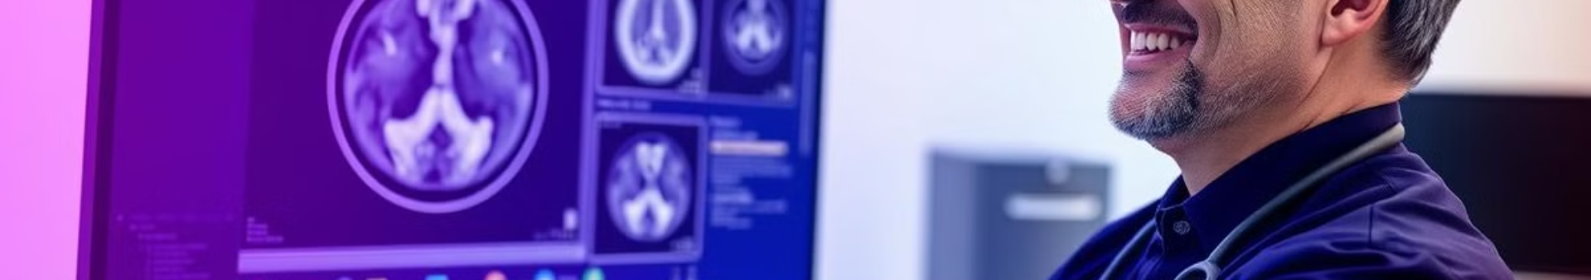
Expected Outcomes: Empowering Medical Professionals
Accurate Tumor Detection
Streamlined Workflow
Improved Diagnosis and Outcomes
The model will be capable of accurately detecting brain tumors from MRI scans, providing medical professionals with a reliable tool for diagnosis.
This project will automate tumor detection, significantly reducing the manual workload for radiologists and freeing up their time for more complex tasks.
By enabling faster and more accurate diagnoses, the model can lead to early interventions and potentially better treatment outcomes for patients.

Slide 8
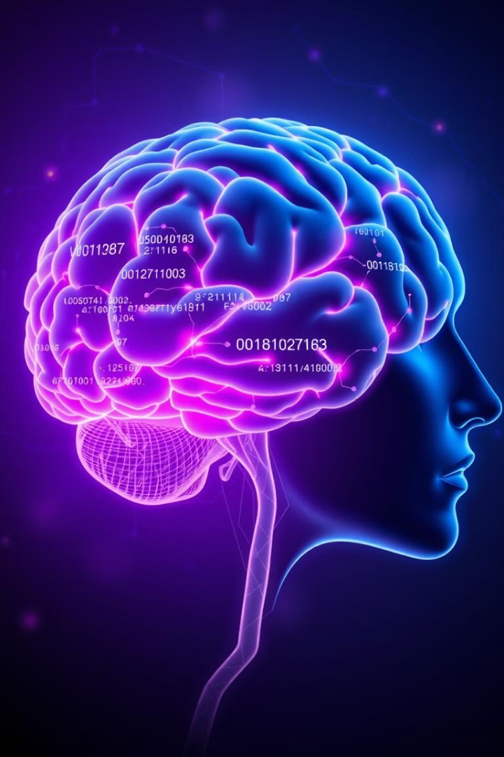



Deployment and Integration: Enhancing Medical Imaging
Cloud-Based Accessibility
Seamless Integration
Collaboration and Advancement
The model will be deployed in a cloud environment, making it readily accessible to medical professionals across different locations and institutions.
The system can be integrated into existing medical diagnostic tools, providing a user-friendly interface and seamless integration into existing workflows.
This project has the potential to foster collaboration between AI researchers and medical professionals, driving innovation and improving healthcare outcomes.

Slide 9

Risks and Challenges: Navigating the Path to Success
1
Data Quality and Bias
We will carefully evaluate the data for potential biases or inconsistencies, ensuring that the model is trained on a representative dataset. This will help to mitigate potential errors and ensure that the model is unbiased.
2
Model Overfitting
We will implement regularization techniques to prevent the model from overfitting to the training data, ensuring that the model generalizes well to unseen data. This will help to improve the model's accuracy and reliability.
3
Ethical Considerations
We will prioritize ethical considerations throughout the project, ensuring that the model is developed and used responsibly, respecting patient privacy and ensuring transparency in its decision-making process.

Slide 10




Conclusion: A Vision for the Future of Healthcare
Transforming Brain Tumor Detection
This project aims to revolutionize brain tumor detection by leveraging the power of deep learning and AI, enabling faster, more accurate diagnoses, and potentially leading to better treatment outcomes.
Advancing AI in Healthcare
The findings from this project can contribute to the advancement of AI in healthcare, paving the way for innovative diagnostic and therapeutic tools that improve patient care.
Empowering Medical Professionals
By automating tumor detection and enhancing diagnostic accuracy, this project will empower medical professionals with advanced tools that support their clinical decision-making.

Slide 11

Next Steps: Moving Toward Implementation
Model Development and Training
We will continue to develop and train the deep learning model, focusing on improving accuracy and generalization to unseen data.
Extensive Validation
The model will be thoroughly validated using independent datasets and expert review, ensuring its reliability and robustness.
Pilot Implementation
We will initiate pilot implementations in collaboration with medical institutions to assess the model's real-world performance and gather valuable feedback.

Slide 12
Conclusion:
This project revolutionizes brain tumor detection by using deep learning to create a system that enhances diagnostic capabilities and significantly improves patient outcomes. This leads to earlier and more effective interventions.
By leveraging a pre-trained model and transfer learning, we aim to enhance diagnostic accuracy, leading to improved patient care through more precise and timely diagnoses. This approach minimizes the need for invasive procedures.
The findings will advance AI-driven medical imaging, contributing to the development of innovative tools that transform healthcare. This promotes more efficient and accessible diagnostic solutions.

